Slide 1
Forecasting Avocado Prices
Bei Wang
2020.7

Slide 2
Overview
Avocado is known as ‘Green Gold’ in world trade. Avocados are a great source of vitamins C, E, K, and B-6, as well as riboflavin, niacin, folate, pantothenic acid, magnesium, and potassium. They also provide lutein, beta-carotene, and omega-3 fatty acids. Although most of the calories in an avocado come from fat, but that fat is very healthy, especially Hass avocados.
Hass avocados are higher in fat than other varieties, which gives them a richer taste and smoother, creamier texture. The taste, benefit of health and food culture make avocados become an important food/fruit to people around the world. It is the main daily food in South America. In most recent years, the avocado sales market is increasing in Asia as well.
Since the avocados market is important to the world, I’d like to forecast avocado prices in the future. I am going to use the dataset of US sales reports from 2015 to 2018 to implement the research.

Slide 3
Goals
Analysis of avocados price changes from 2015 to 2018.
Predict the avocados price in the future.

Slide 4
Methodology
This is a time series problem, I am gonna use prophet, ARIMA and EMA to compare the result.

Slide 5
Data and Description
I use avocados price dataset including the price from 2015 to 2018, Time Series will be the
basic technique type in the project.
Data source: https://www.kaggle.com/neuromusic/avocado-prices
Some relevant columns in the dataset:
Date - The date of the observation AveragePrice - the average price of a single avocado type - conventional or organic year - the year Region - the city or region of the observation | Total Volume - Total number of avocados sold 4046 - Total number of avocados with PLU 4046 sold 4225 - Total number of avocados with PLU 4225 sold 4770 - Total number of avocados with PLU 4770 sold

Slide 6
Data Wrangling
Dataset is quite clear, no null data or missing data.
Sort the dataset in a new csv file.

Slide 7
Exploratory Data Analysis
At the beginning, let's check the distribution of orders in each year.

Slide 8
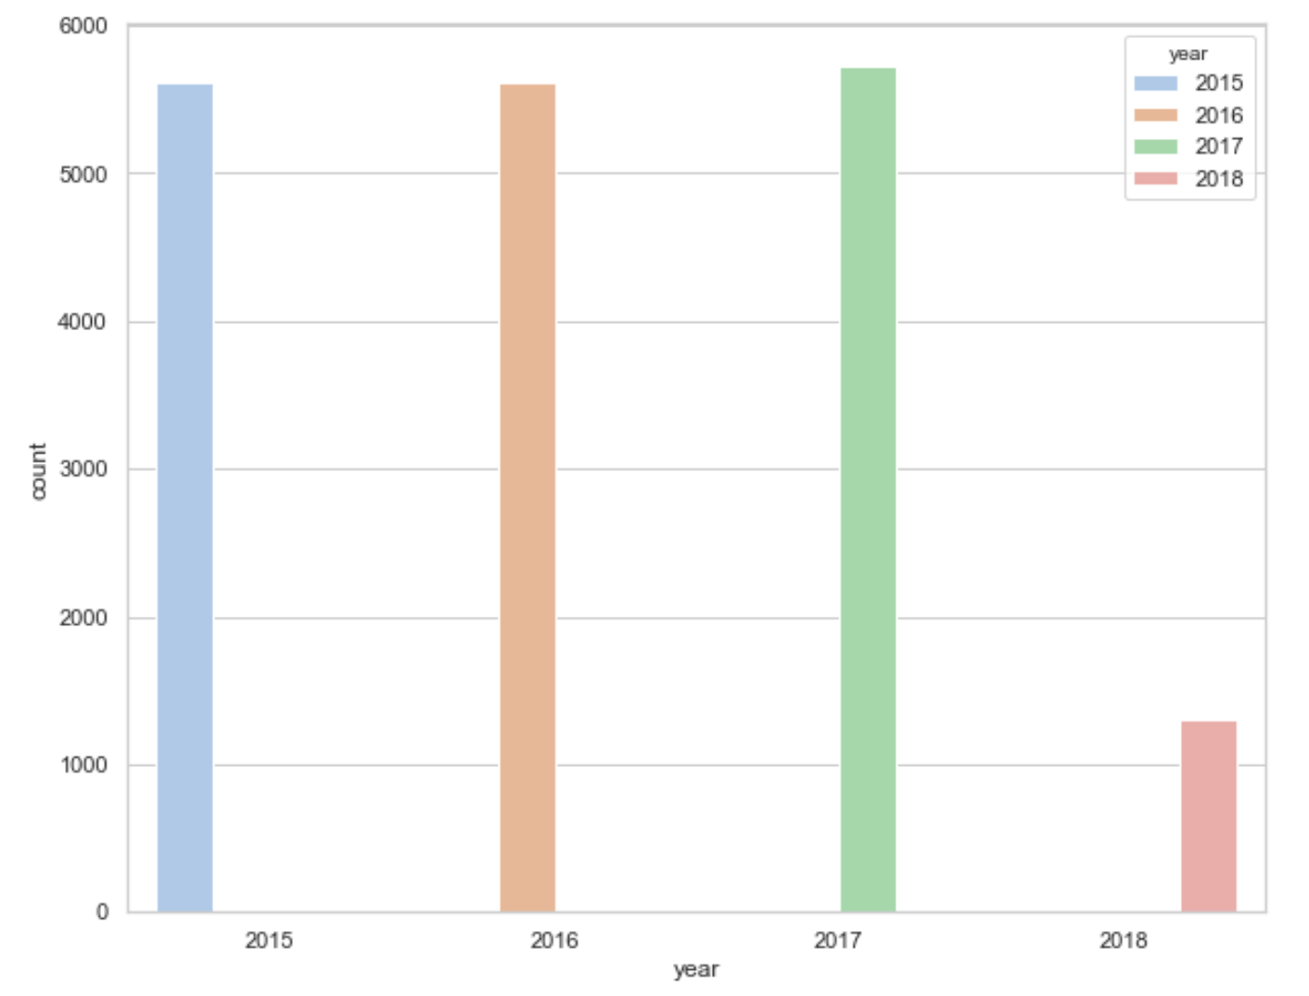
Overview of the Sales
The counts of 2015 to 2016 are similar, 2016 reached the highest point. 2018 only collected 3 months of data, so it's short.
The counts of 2015 to 2016 are similar, 2016 reached the highest point. 2018 only collected
3 months of data, so it's short.

Slide 9
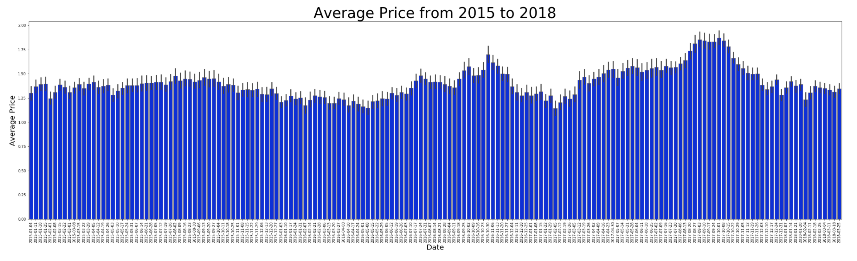
Overview of the Average Price
If the average price fluctuation from 2015 to 2018?
Throughout 2015, prices were relatively stable.
From 2016 to 2018, prices showed an upward trend,especially in September 2017, it reached the peak of four years.

Slide 10
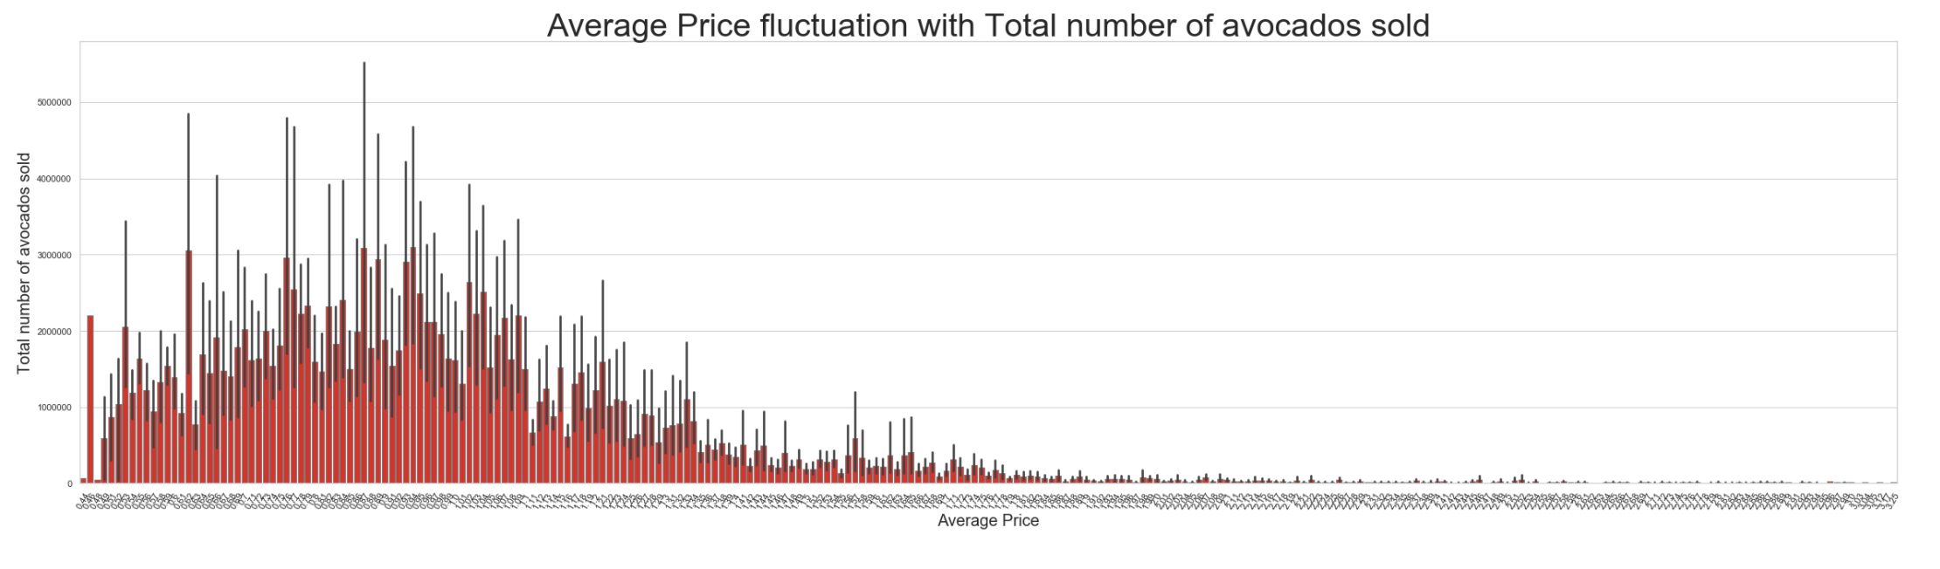
Price Affect the Sales Volume
So, does the price fluctuations affect sales volume?

Slide 11
Sales volume does affect price fluctuations: low prices bring high sales, and high prices
bring low sales. But there are some exceptions.
For example: price as low as $0.44 and $0.48 cannot bring a higher sales:
Two lower Prices with lower sales occurred in Cincinnati Dayton and Phoenix Tucson, I
cannot find any news related to the local avocado retail market, which may be caused by
special circumstances.

Slide 12
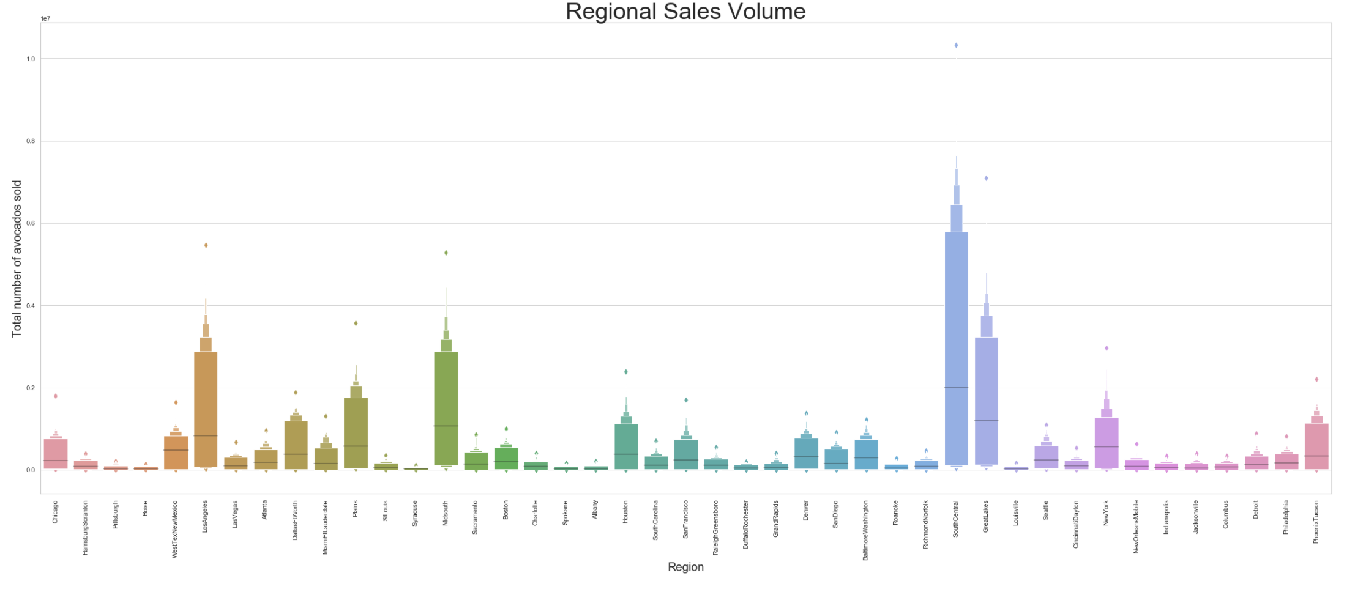
Regional Sales
In the dataset, avocados were sold in most cities of the USA. How is the sales volume in each city? Where is the best sales market of avocados?

Slide 13
South Central is the topest sales city. Cities with better sales are distributed widely, with a
certain proportion in the Midwest and Northeast.

Slide 14
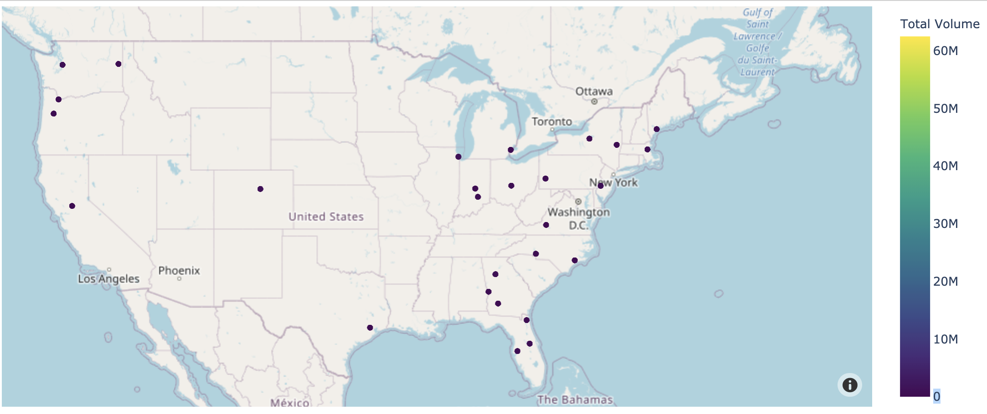
Cities' sales volumes distribution in the map will be clearly:
In the map, It can be clearly seen on the map that sales markets are mainly concentrated in the Northeast and West coast. The reason may be related to the popularity of local food and the dense population of eating.

Slide 15
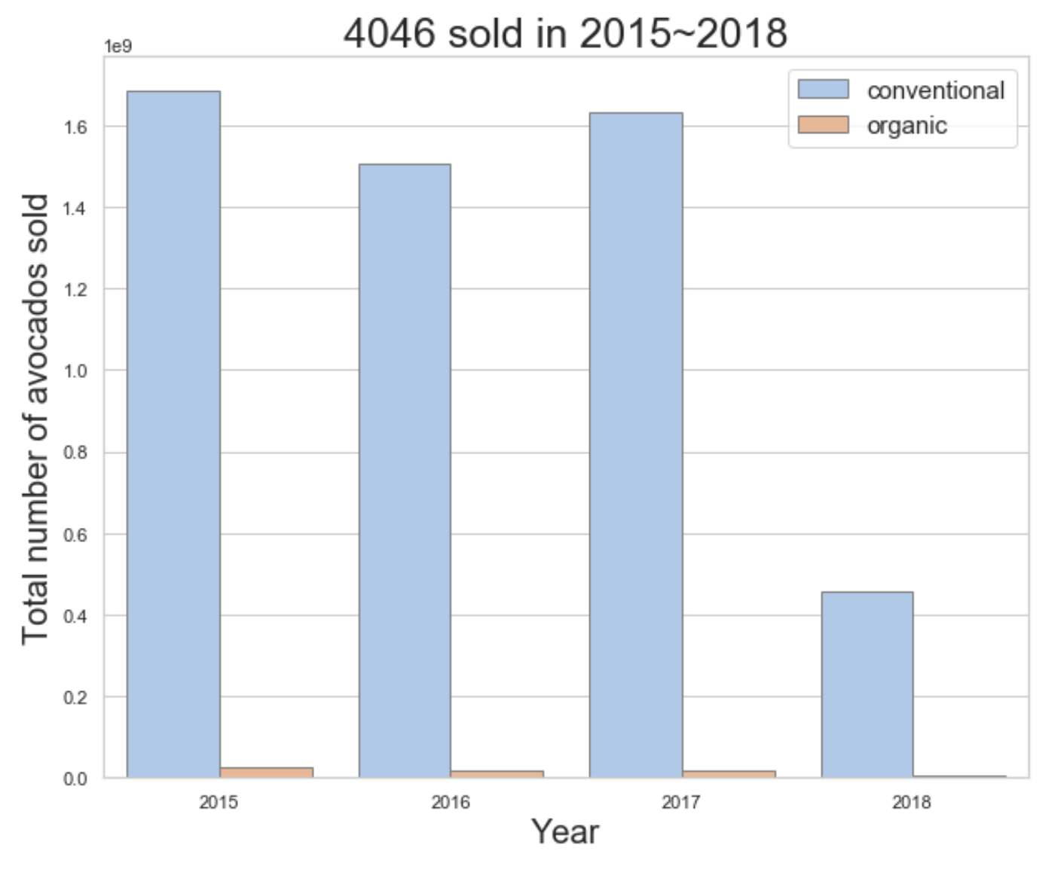
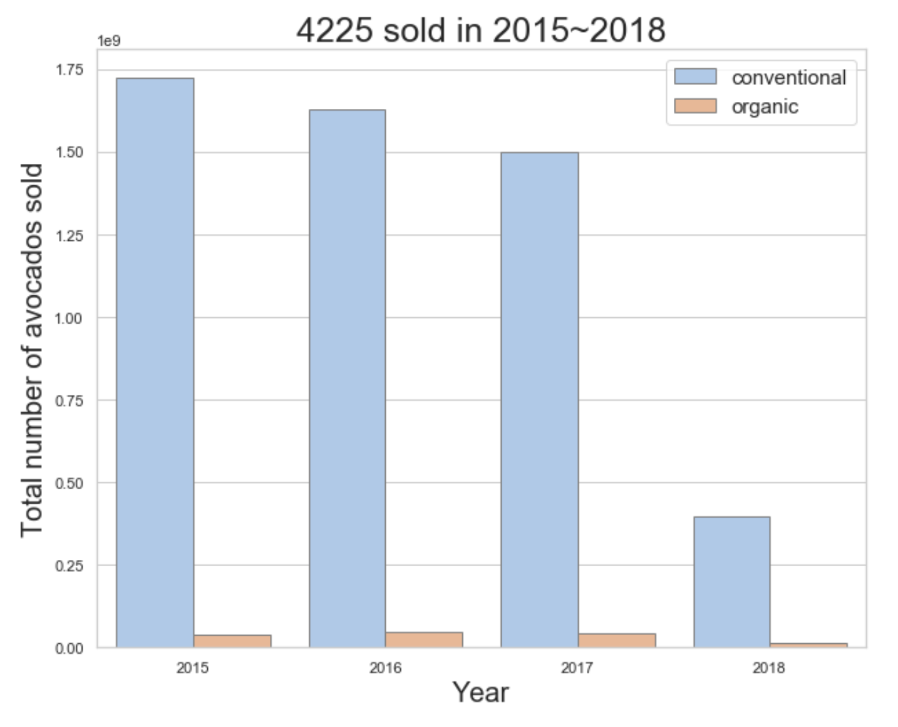
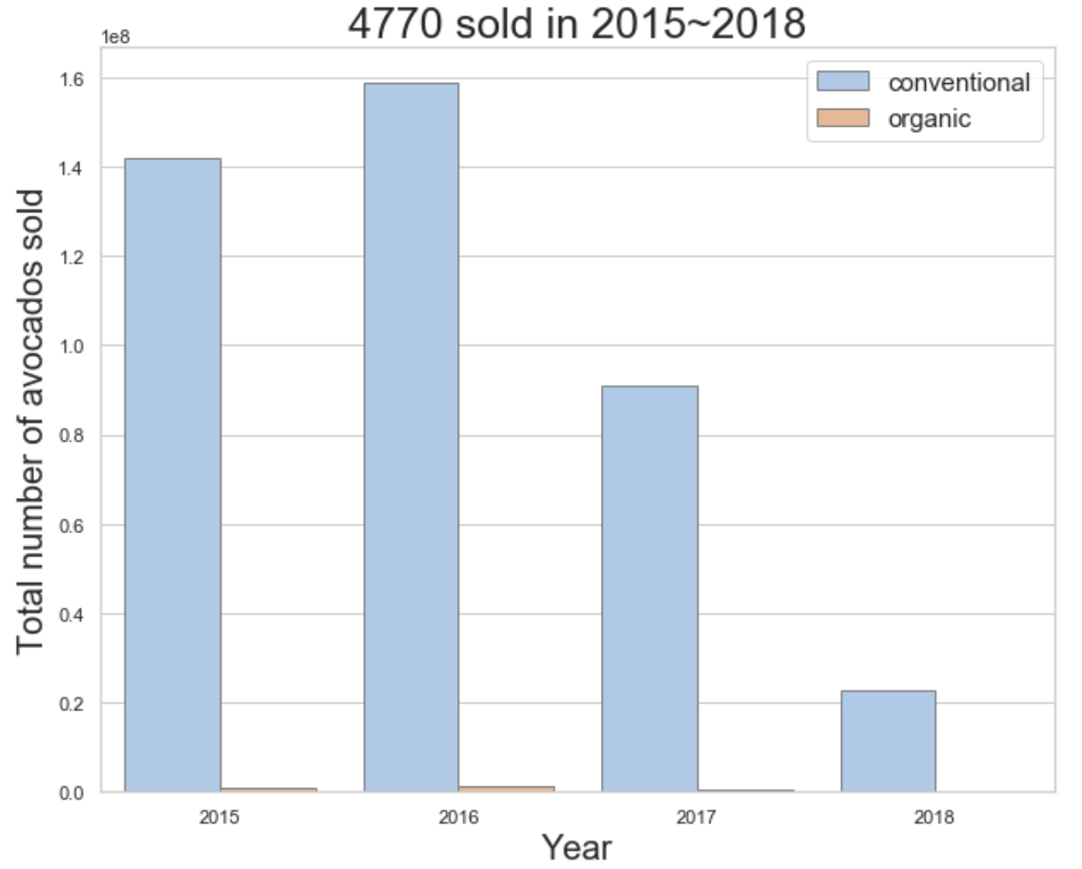
Compare Sales Volume of 3 Avocados of PLU
I got the sum of the 3 avocados varieties sold in 3 years with 2 kinds of types, comparing them by plots.

Slide 16
No matter what kind of avocado, the sales volume of conventional(non-organic) avocados
is much higher than organic sold.

Slide 17
Compare Price Difference Between Organic and Non-Organic
Is that the price caused by the difference of the sales volume between non-organic and
Organic? Let's go dig in the price difference of non-organic and organic.

Slide 18
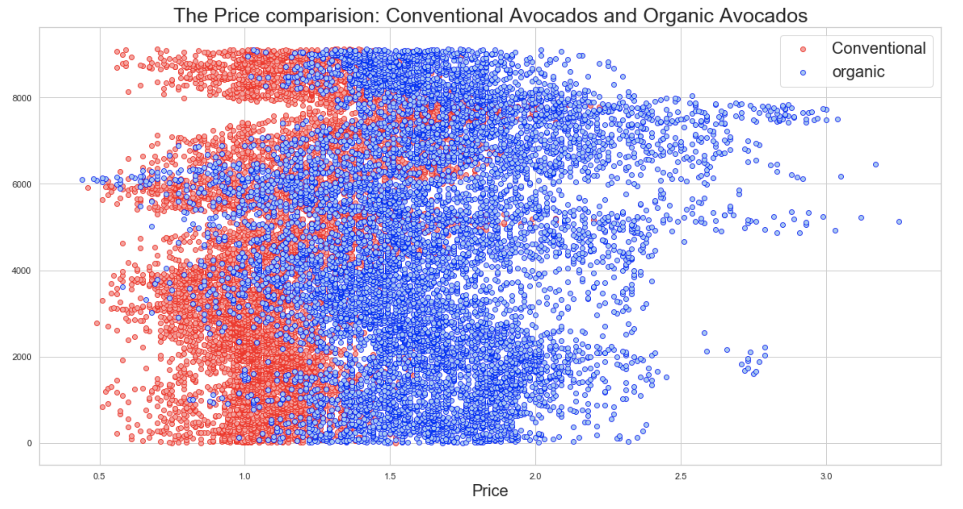
Although the chart shows that the price of most organic avocados is higher than that of non-organic avocados, it is not difficult to find that the prices of the two kinds of avocados have a large overlap, and both have reached the highest and lowest prices.
Therefore, can I determine that is the price a certain factor that leads to product sales?I will do a hypothesis test for it later.

Slide 19
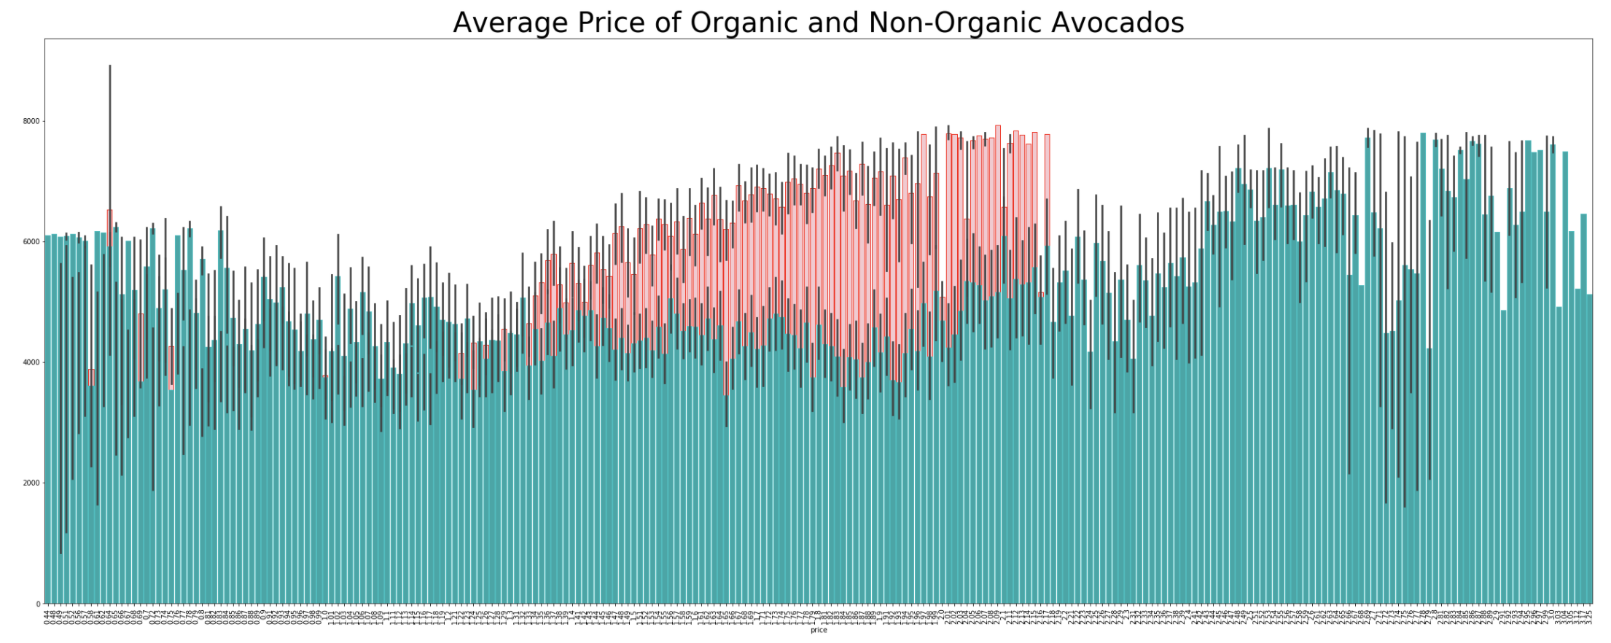
Before doing hypothesis testing, I’d like to overview the average price difference of organic and non-organic in bar plot again:

Slide 20
In this chart, it is obvious that both organic avocado and non-organic avocado have reached the highest point in price, so is price still the guiding factor for the two types of sales?
Let me do hypothesis testing to verify it.

Slide 21
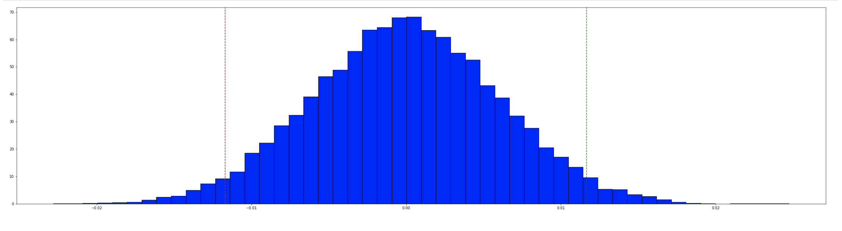
H0: There is a difference in average price between organic and conventional.
H1: There is no difference in average price between organic and conventional.
After calculation, I got the P value is 0.00, when 𝛼=0.05, p = 0.00 indicates that there is no
actual difference price between organic and conventional. H0 rejected.

Slide 22
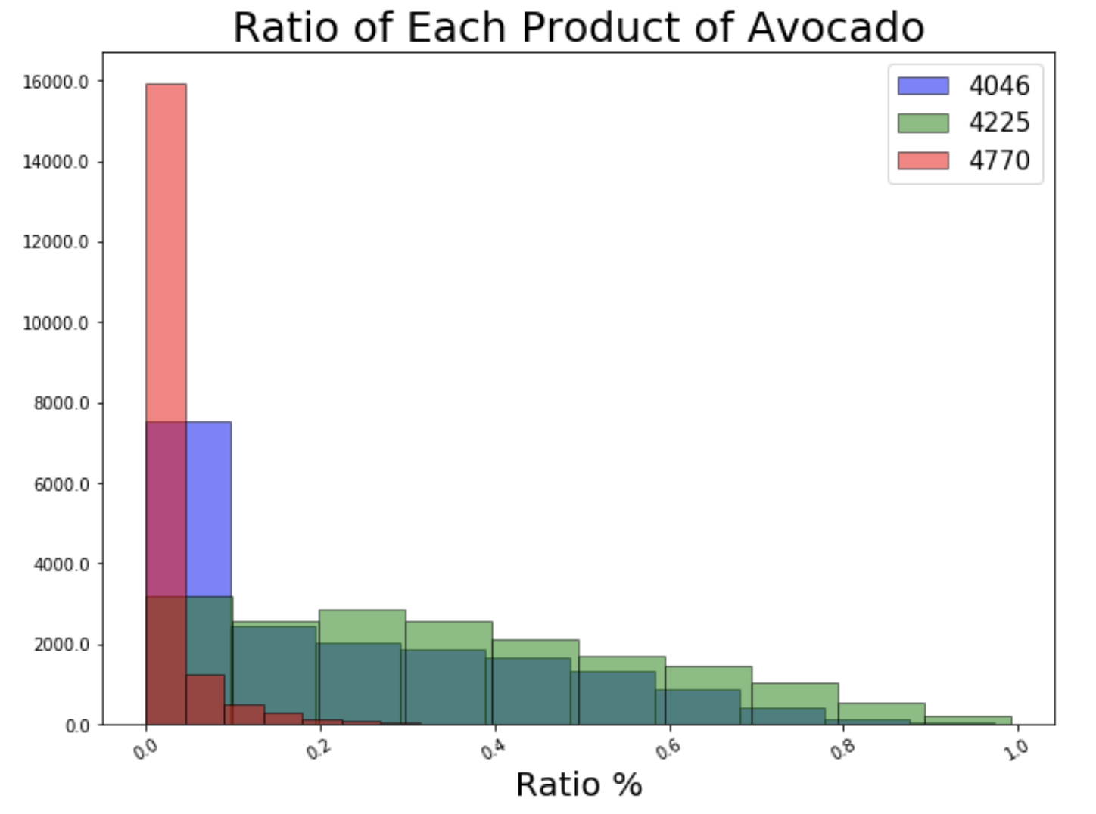
Rates of 3 Types of Avocados Sale
Think about 3 products of avocados with different PLU, what is the ratio of each product sale of total sales?
In most of time, 4770 accounted for 0.5% of total sales.
4046 and 4225 accounted average sales of total sales, ranging from 0.1% to 0.89%.

Slide 23
Sales During the Specified Period
If avocado sales fluctuate by seasonal? To achieve this, I am going to do research by monthly sale during a year and daily sale during a month. Since all data collected by each Sunday, I will not do weekly sale analysis here.

Slide 24
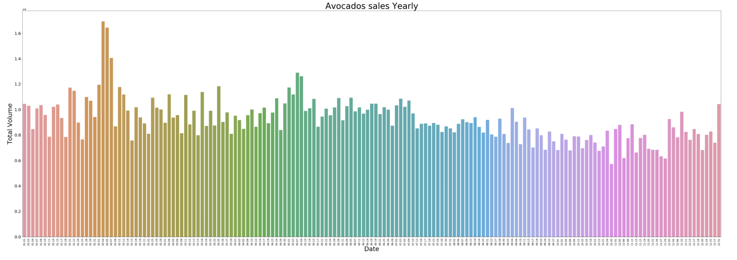
Overview the Sale
In this plot,total sales are relatively average except for a few days in February.

Slide 25
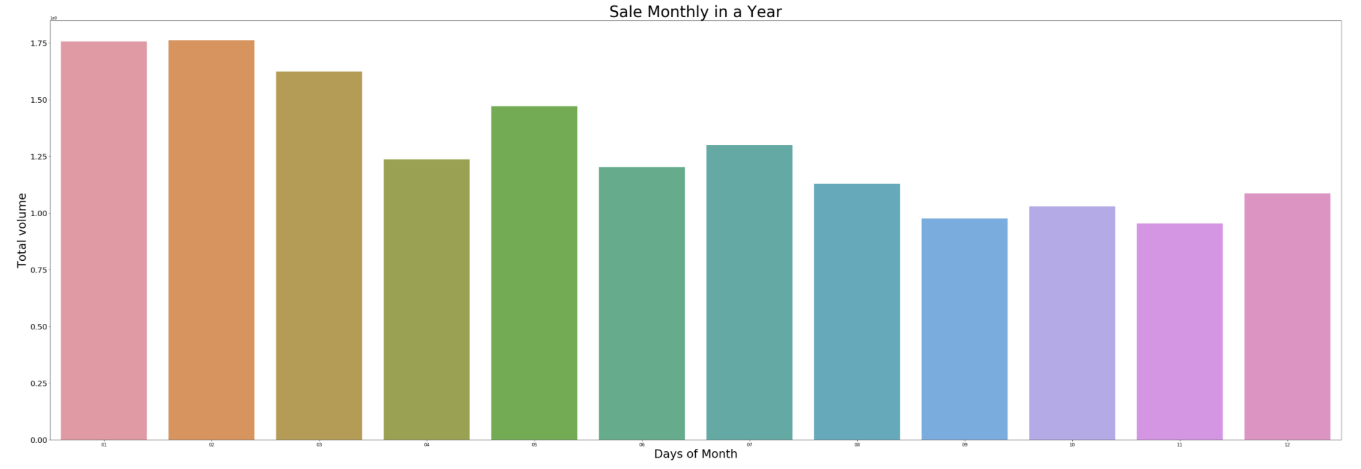
Sales During the Month
In the monthly plot, we can easy to find the highest sales volume happen in first 3 months of the year, while yearly sales are slowly declining in waves.
In the above, I have obtained corresponding analysis results by analyzing prices and sales volume, sales volume of products by category, organic and non-organic sales volume and price, and combining four-year data to sales volume within one year.

Slide 26
Forecasting Result
There are two types of avocado: conventional and organic, in this part, I will focus on conventional avocado's price in the total US. Forecast conventional avocado's price from 3 ways to compare the result:
Prophet
ARIMA
EMA

Slide 27
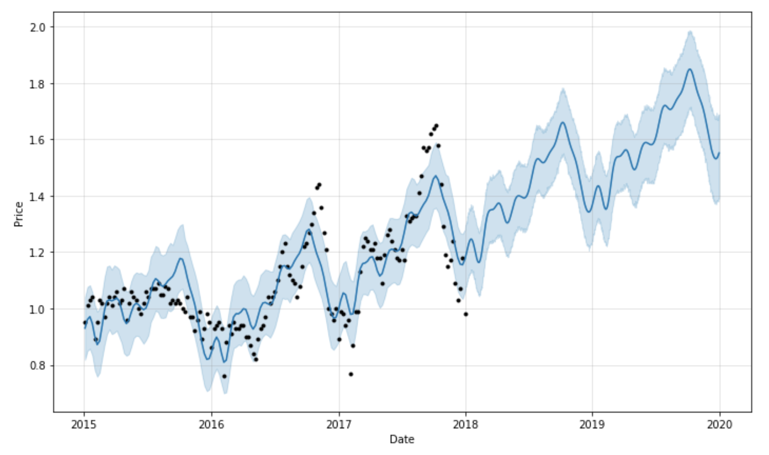
Prophet
Let's start from the prophet.
Calculate Prophet Prediction
We had the price of avocado from 2015 to 2018, it shows as the black spots part in the graph. The future price after 2018-03 in the graph indicates the price will frequency oscillation go up.

Slide 28
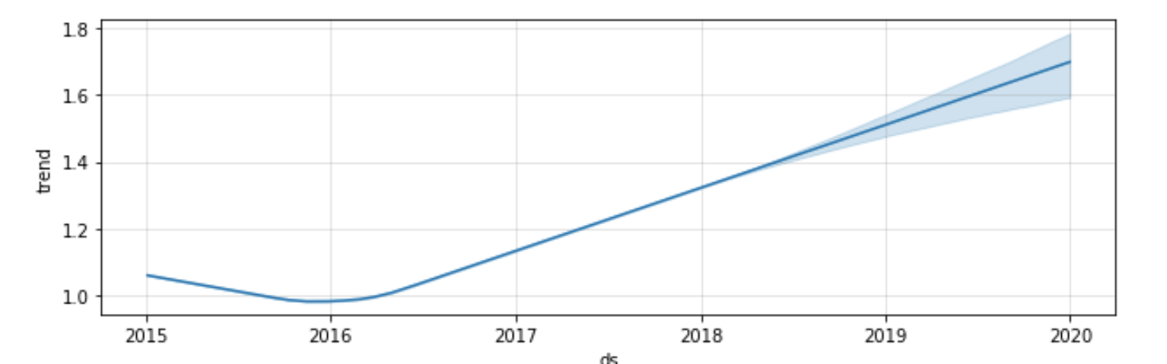
Plotting the estimated components of the model shows the same result.

Slide 29
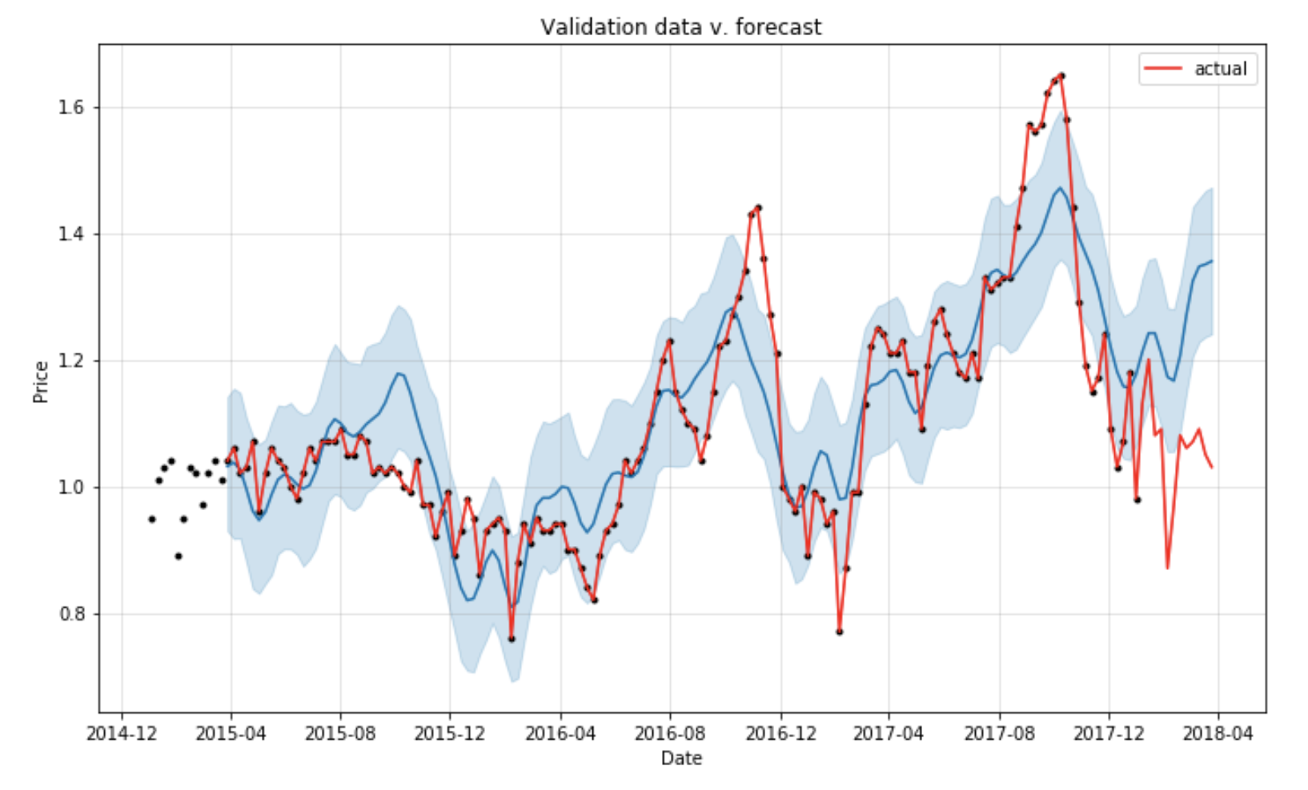
Valuation
Take original data of 2018 as a valuation.
The actual price and predication price in the same plot. Two price trend shapes are pretty similar but do not match very well.
Let’s do R² valuation: Coefficient of determination R² value is 0.9486081370449679, R² close to 1, means
the fit difference is really small, and the model fits very well.
The result of prophet prediction can be a reference.

Slide 30
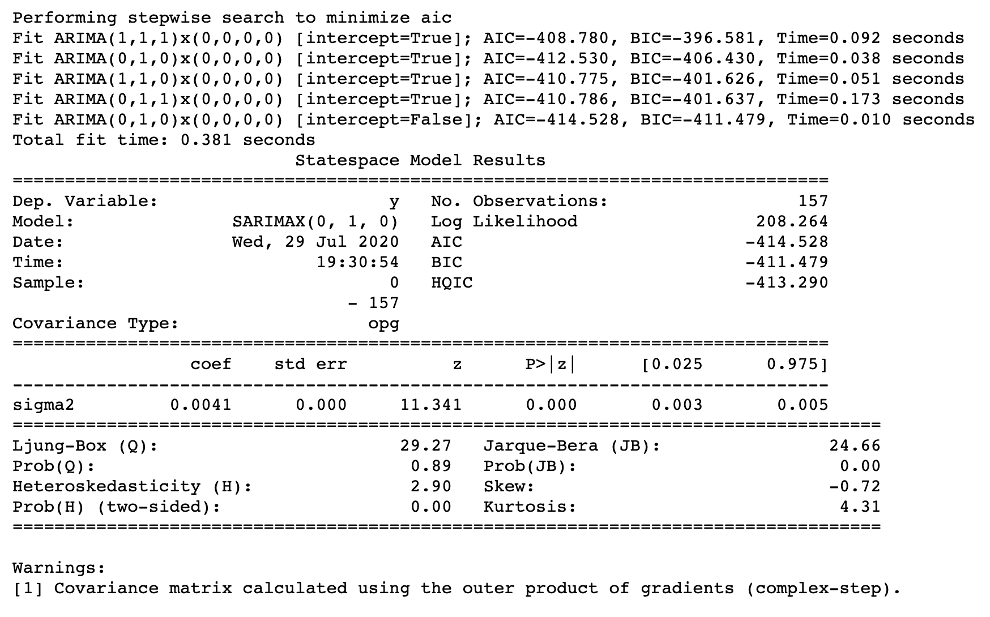
ARIMA
I use the AIC calculator engine to find the best model to define p, d, q values. The result is: AIC:-214.528 is the lowest, ARIMA(0, 1, 0)x(0, 0, 0) is the best model.

Slide 31
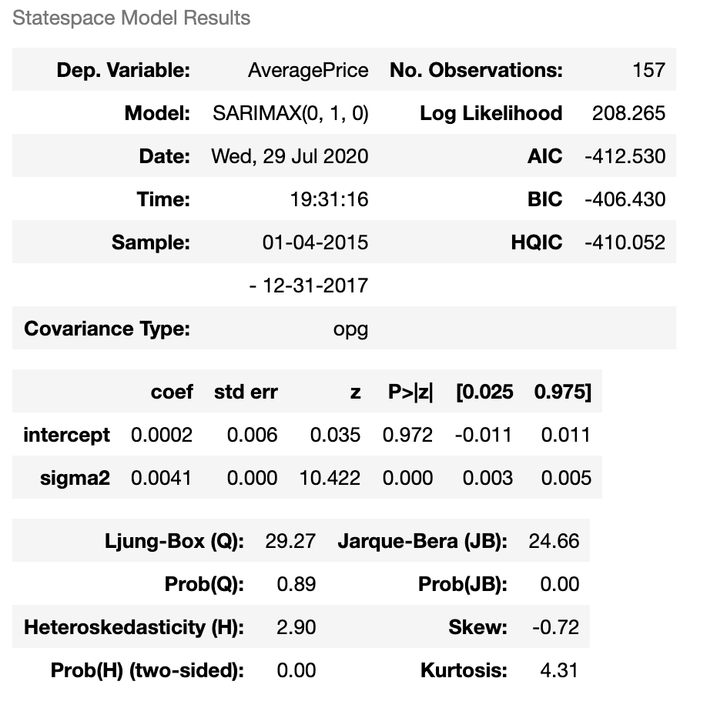
After model fit, state space model results table shows each values as below:

Slide 32
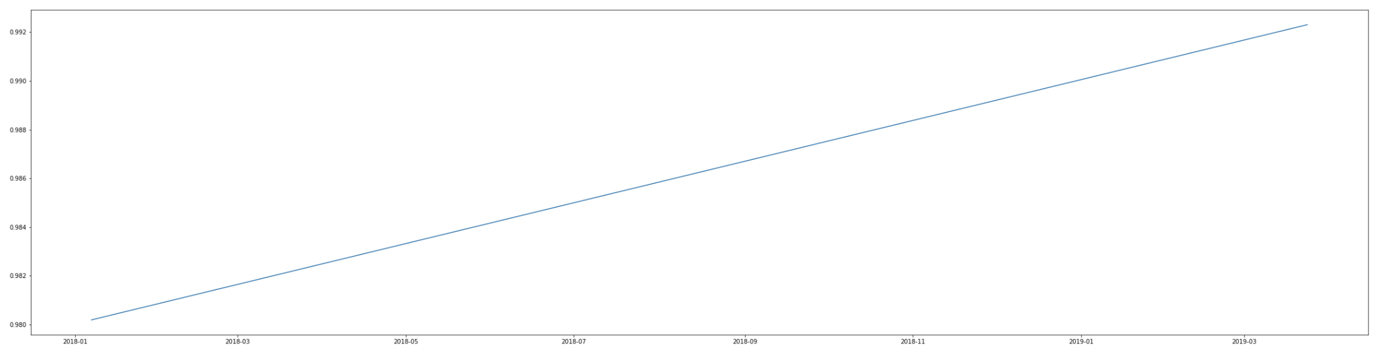
The range of average price in the future is $0.98 to close to $1.00.
ARIMA predicts the future price after 2018-03-25 before 2020-03-24, in the graph indicates the price will go up.

Slide 33
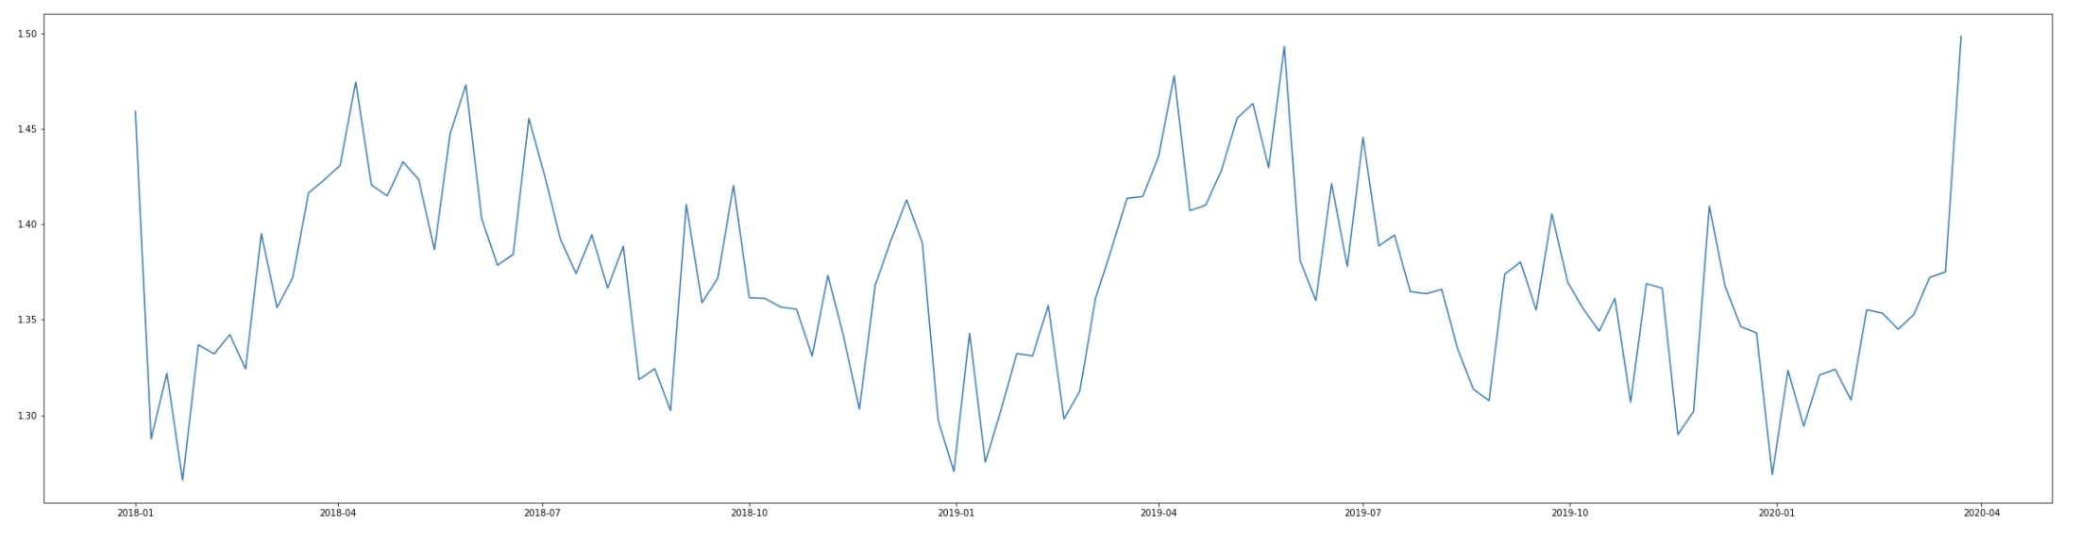
EMA
Exponential Moving Average shows the price in the future will be frequency oscillation, but cannot tell the trend is go up or go down.

Slide 34
Conclusion
Three of the predictions show the similar result. EMA responds quickly to any factor’s change, better than ARIMA in this project, Prophet shows more details, clearest average price trend. In this project, the Prophet gives the best forecasting.
Combining three models above, the average price of conventional avocados will be frequency oscillation go up in the future.

